Slide 1
PERFORMANCE OF CONTRACT OF SALE OF GOODS

Slide 2
MEANING
The performance of a contract of sale implies delivery of goods by the seller and acceptance of delivery of goods and payment for them by the buyer, in accordance with the contract.
Delivery of goods by the seller
Acceptance of delivery of goods and payment of price by buyer

Slide 3
Delivery
Delivery of goods means voluntary transfer of possession of goods from one person to another [Sec 2(2)]
MODES OF DELIVERY
1. Actual delivery
2. Symbolic delivery (When the good is bulky)
e.g. keys of the car or godown.
3. Constructive delivery
Where a third person has the possession of goods on behalf of buyer.
e.g. A warehose keeper, a carrier

Slide 4
RULES AS TO DELIVERY OF GOODS
Delivery may be Actual, Symbolic or Constructive (Sec. 33)
Delivery and payment are concurrent conditions (Sec. 32)
Unless otherwise agreed, delivery and payment must be made simultaneously.
Effect of part delivery (Sec. 34)
When a delivery of part of goods has been made with an intention to deliver the whole goods, the property in the whole goods is deemed to pass to the buyer as soon as a portion is delivered.(Dixon vs Yates)
When delivery of part of goods has been done without intention of delivering the whole goods then property do not pass.

Slide 5
4. Buyer to apply for delivery (Sec. 35)
A seller is not bound to deliver the goods until the buyer ask for it.
5. Time of delivery [Sec. 36(2) & 4]
If the time of delivery is not mentioned then it should be deliverd within reasonable time.
6. Place of delivery [Sec. 36(1)
In case of ‘Sale’ the goods must be delivered at the place where they are at the time of sale.
In case of Agreement to sale the goods must be delivered at a place where they are the time of making the agreement.
In case of future goods, the goods are to be delivered at the place where they are manufactured or produced.
7. Delivery of goods where they are in possession of a third party
[Sec.36(3)]
The delivery is deemed when the third person acquires that he holds the goods on behalf of buyer.

Slide 6
8. Expenses of delivery [Sec.36(5)]
Unless otherwise agreed, Expenses of putting the goods into deliverable state is borne by the seller and expenses of delivery is borne by the buyer.
9. Delivery of wrong quantity (Sec. 37)
Shortage, Excess delivery Mix delivery
To reject the whole goods
To accept the whole goods
To accept the quantity or quality he ordered and reject the remaining.
10. Installment Deliveries [Sec 38]
Unless otherwise agreed, the seller is not entitled to deliver the goods in installment.
11. Delivery of goods to carrier or wharfinger [Sec 39]
When goods are delivered to carrier for transmission, it is treated as delivery of goods to the buyer.

Slide 7
ACCEPTANCE OF DELIVERY BY THE BUYER
According to sec. 42 a buyer is deemed to have taken the delivery of goods in the following circumstances:
When he intimates the seller that he has accepted the goods.
When he does any act in relation to the goods which amounts to acceptance of goods, e.g. consumes, uses, pledges or resells goods.

Slide 8
UNPAID SELLER

Slide 9
UNPAID SELLER
The definition of ‘unpaid seller’ is provided in section 45 of the Sale of Goods Act.
“the seller of the goods deemed to be an unpaid seller :
when the whole of the price has not been paid
when a bill of exchange or other negotiable instrument has been received as conditional payment and the condition on which it was received has not been fulfilled by reason of the dishonour of the instrument or otherwise.”

Slide 10
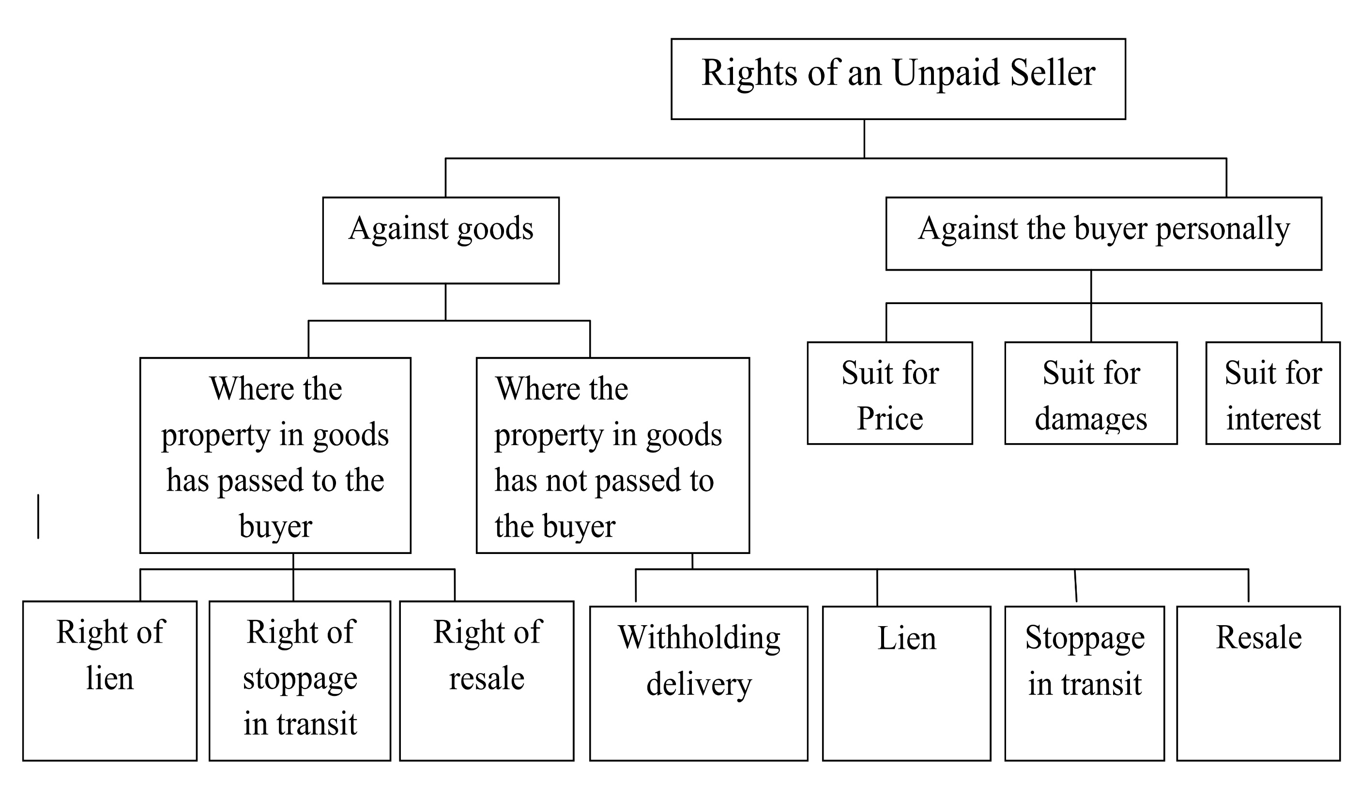

Slide 11
RIGHT OF LIEN
Right to retain goods by unpaid seller till amount is recovered from the buyer is called right of lien. If unpaid seller wants to exercise right of lien, he has to fulfill the following conditions.
There should be no credit terms in the Contract of Sale.
If there is a credit term, right of lien can be exercised after completion of credit period.
Where the buyer becomes insolvent.
When Lien is lost
The unpaid seller loses his right of lien in the following cases
When goods are delivered to the carrier and seller does not retain the right of disposal.
When agent of the buyer has obtained possession of the goods.
When unpaid seller waives his right of lien.

Slide 12
RIGHT OF STOPPAGE IN TRANSIT
Unpaid Seller has right to stop the goods in the transit itself. To exercise this right the following conditions are to be fulfilled.
Buyer must be insolvent.
The property has passed to the buyer.
The goods are in the course of transit.
The transit comes to an end in the following cases:
When the buyer or his agent takes delivery of the goods after the goods have reached the destination.
When the buyer or his agent obtains delivery of the goods before the arrival of the goods to the destination.
When the goods have arrived at the destination and carrier acknowledges that he holds goods on behalf of the buyer.
When the carrier wrongfully refuses to deliver the goods.
When part delivery has been made to the buyer, with an intention to deliver the whole goods.

Slide 13
RIGHT TO RE-SALE
The unpaid seller can re-sell the goods for non-payment of price by buyer.
when the goods are of perishable nature the seller may sell the goods without any notice to the buyer.
When the unpaid seller has exercised his right of lien or stoppage in transit, he has to give a notice to the buyer about his intention to sale the goods. There upon the buyer may pay the price.
If the buyer does not pay seller can resell the goods and can recover the damages from original buyer.
However, when the seller sells the goods without any notice to the original buyer. He cannot claim damages.
The new buyer acquires a better title.

Slide 14
RIGHT OF UNPAID SELLER AGAINST BUYER
Suit for price (Sec. 55). When property in goods have been passed to the buyer and the buyer refuses to pay the price according to terms of contract, the seller is entitled to sue him for price.
Suit for damages for non-acceptance (Sec. 56). Where the buyer wrongfully neglects or refuses to accept the goods, the seller can sue him for damages. The seller can claim (a) any loss due to non-acceptance (b) any reasonable charge for care and custody of goods.
Suit for interest (Sec. 61). When there is an agreement between seller and buyer about payment of interest of the price of goods from the date on which the payment becomes due, the seller may charge interest from the buyer.

Slide 15
THANK YOU

