Slide 1
AMBANI FAMILY CONFLICT
TORAN LAL VERMA
DHSGU, SAGAR

Slide 2
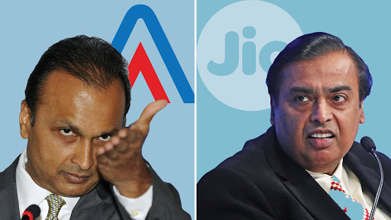
Conflict in Ambani Family is widely discussed example of conflict in family businesses

Slide 3
AMBANI FAMILY CONFLICT
During their younger years, the brothers worked together at Reliance Industries under their father, Dhirubhai Ambani. During this time, it was reported that the brothers displayed remarkable interpersonal chemistry, sometimes even finishing each other’s sentences. It was a widely held belief that the two would eventually both take over Reliance Industries and run the business empire side by side.

Slide 4
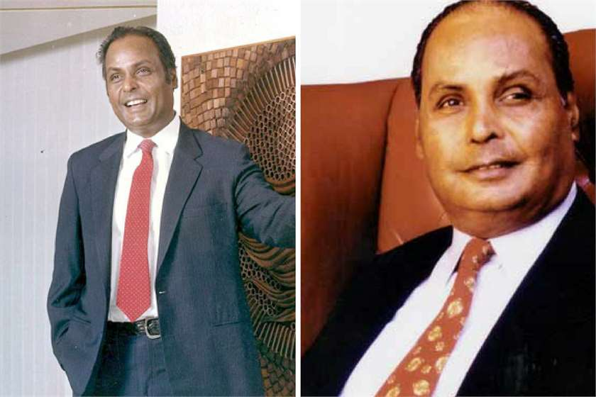
EVERYTHING WAS OK TILL DHIRUBHAI AMBANI WAS IN THE BUSINESS

Slide 5
July 2002: Dhirubhai Ambani dies
Dhirubhai Ambani, the founder of Reliance Industries died in 2002 after suffering a massive stroke.
The patriarch hadn't left a will and his elder son Mukesh Ambani became chairman and managing director of Reliance Industries Ltd while his younger son, Anil Ambani was made vice-chairman.
Mukesh reportedly tried to oust Anil from the board.
Group has sales turnover of ₹ 52,110 crore and market cap of ₹ 37,688 crore on March 31, 2002.

Slide 6
November 2004: The private rift between the brothers becomes public
In an interview with CNBC TV18 Mukesh Ambani admitted that the brothers disagreed on the running of the Ambani Group.
He said: 'Well, there are issues which are ownership issues. These are in the private domain, but as far as Reliance is concerned it is a very-very strong professional company.'
At the time the Ambanis had a 46.67% stake in Reliance Industries Ltd, the public 13.48%, and foreign institutional investors 22.85%.

Slide 7
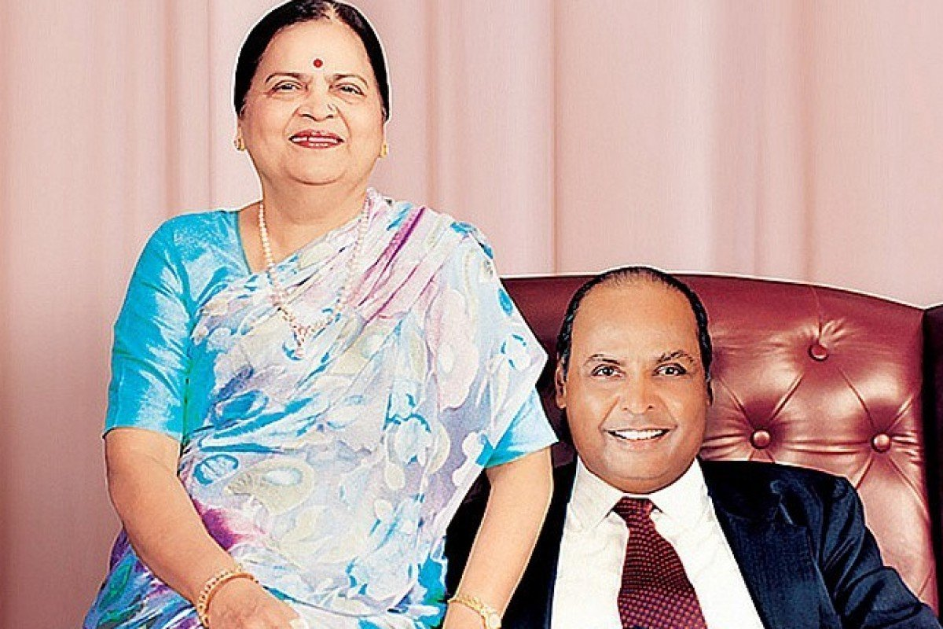
June 2005: Their mother, Kokilaben, intervenes and splits Reliance Group into 2
The Ambani brothers settled their dispute after their mother Kokilaben intervened and arranged a de-merger.
The combined Reliance Group has a sales turnover of ₹ 83,310 crore and market cap of ₹ 92,697 crore on March 31, 2005.
Mother had to step in

Slide 8
December 2005: The split is approved
The Bombay High Court approved the de-merger for Reliance Industries shareholders after it was accepted by the Bombay Stock Exchange and the National Stock Exchange.
Mukesh Ambani got Reliance Industries and IPCL, while Anil was given control of Reliance Infocomm, Reliance Energy and Reliance Capital.
Some shareholders opposed the decision saying it was more a family arrangement than a business separation.

Slide 9
November 2006: Anil Ambani's Reliance Group challenges a gas contract signed by Mukesh's company during the split
Anil Ambani, who controlled Reliance Group, publicly questions the terms of the gas supply agreement signed between Mukesh's Reliance Industries Ltd and Anil's Reliance Natural Resources Ltd at the time of the demerger.
Mukesh's exploration company was reportedly going to sell gas to Anil's power company at a reduced rate. When the government would not approve the deal, Anil suspected covert dealings with his brother.
Anil also said the agreements were signed before Anil took charge of them.

Slide 10
Early 2008: nil accuses Indian Petroleum Minister Murli Deora of secret dealings with his brother
Mukesh's exploration company was supposed to sell gas to Anil's power company at a discounted rate. The deal was vetoed by Deora who said neither company had the right to trade the government's gas at discounted rates. Anil accused Deora of siding with his brother and said the ruling would essentially double Mukesh's gas profits to £6 billion.
At a press conference with shareholders in 2009 Anil said: RIL has tried every trick in the book and apparently several outside the book to back out of its solemn, legal and contractual obligations. It is plain and simple corporate greed of Reliance Industries.'

Slide 11
September 2008: Anil Ambani files a defamation suit over statements Mukesh made to The New York Times
Anil Ambani filed a $2.12 billion defamation suit against Mukesh for remarks he made during an interview with The New York Times.
The Times had written about an 'intelligence agency', a network of lobbyists and spies who gathered information about India's most powerful. Mukesh had in response said that they had 'de-merged all of that' and that those activities were overseen by Anil.

Slide 12
June 2008: One of Anil's companies is suspected of losing a deal because of Mukesh's involvement
Anil's company, Reliance Communications, called off merger talks with South Africa's MTN, a multinational mobile telecommunications company. The company said there were legal and regulatory issues to deal with.
Mukesh's claim on the shares of Anil's telecom firm was also blamed for the failed deal.

Slide 13
Summer 2009: Anil blames his brothers' company for power cuts sweeping across India
Anil Ambani addressed a letter to Indian Prime Minister Manmohan Singh in which he said: 'Major power cuts, especially in north India, have become commonplace, causing grave hardship to hundreds of millions of consumers -- sadly, all a result of RIL's corporate greed.' He also asked that the oil ministry stay out of a commercial dispute between the companies.
In 2008, opposition parties had alleged that the Prime Minister's Office had interfered with Reliance's businesses after Singh's meeting with Mukesh. At the time the office released a statement that said: The PM meets corporate leaders all the time to discuss national economic issues, as any leader of a modern economy would… people of India know Manmohan Singh better than to believe he would get involved in corporate affairs.'

Slide 14
April 2009: Anil Ambani survives assassination attempt. The attempt was not related to the feud.
Anil Ambani's private helicopter was tampered with and mud and pebbles were found inside the choppers gear box. The Anil Dhirubhai Ambani Group filed an official complaint saying that Anil's life was under threat and alleged that his rivals were trying to kill him. The attempt had no links with the feud.
Mysteriously though, Bharat Borge, the man who discovered the pebbles in the fuel tank, was found dead at a train station in Mumbai.

Slide 15
July 2009: A Mumbai court is forced to order the brothers' companies to enter a gas supply agreement
A Mumbai's High Court gives Mukesh Ambani's Reliance Industries and Anil Ambani's Reliance Natural Resources Ltd. a deadline: Six weeks to sign a gas supply agreement.

Slide 16
August 2009: Anil Ambani takes out ads criticising his brother's Reliance Industries and the government
Anil Ambani's Reliance Natural Resources Ltd. placed daily advertisements in The Times of India, India's largest newspaper, and 32 other papers alleging that the Indian government had sided with Mukesh's Reliance Industries to raise the price of gas from the The Krishna Godavari basin.
The ad claimed Reliance Industries would gain huge profits and electricity bills would jump by 50%.

Slide 17
August 2009: The Indian finance minister begs the brothers to stop feuding for the sake of the capital markets
India's finance minister Pranab Mukherjee said the corporate dispute had become a matter of 'national interest' and requested the brothers to resolve their dispute privately. He feared the impact of their feud on the markets.

Slide 18
October 2009: The brothers go to the Supreme Court over the gas dispute
Reliance Industries appeals the High court ruling at the Supreme court. Meanwhile the government filed an appeal at the court saying that gas is state-owned and can't be claimed by corporate entities.

Slide 19
May 2010: Supreme Court rules in Mukesh's favour
The Supreme Court ruled in Mukesh's favour and declared that Reliance Industries could sell gas to Anil Ambani's Reliance Natural Resources Ltd. at government-set prices that were higher than those agreed on in a 2005 family agreement.
Anil said that he would not request a review of the verdict. The companies were given six weeks to renegotiate their agreement.

Slide 20
May 2010: Ambani's mother brokers a peace agreement between the brothers
Kokilaben brokered a peace agreement between the brothers. Officials of Reliance Industries Ltd. and Anil Dhirubhai Ambani Group both received notes that said the Ambani brothers would draft a non-compete agreement, to replace an earlier one that obviously didn't work.
RIL, ADAG cancel 2006 non-compete agreements, hope to work in harmony. Two groups cancelled all non-compete agreements that were signed in 2006.

Slide 21
June 2010: Anil Ambani withdraws his defamation suit
A spokesman for or the Anil Dhirubhai Ambani Group issued a statement: 'Yes, we have withdrawn the suit claiming Rs 10,000 crore (or $2.12 billion) as damages.'

Slide 22
August 2010: Anil says the feud has been resolved
'We have parted on a very cordial note and investors should have no fear whatsoever. This is a one-way street...it's a car with no reverse gear... I look at it simply as an issue that needed to be resolved and it has been resolved. It's a new beginning for me and going forward. I am sure Mukesh will do extremely well.'

Slide 23
December end 2011
Family gathers at Chorwad in Gujarat to celebrate Dhirubhai Ambani’s birthday, unveil his memorial. Ambani brothers Mukesh and Anil will be seen together in a family reunion for the first time in recent past. Addressing local media, Kokilaben said,
‘‘They are both my sons; they are progressing well in their businesses. There is love between them. The Ambani family stands together.’’
This statement leaves people guessing if this is a prelude to brothers getting together.

Slide 24
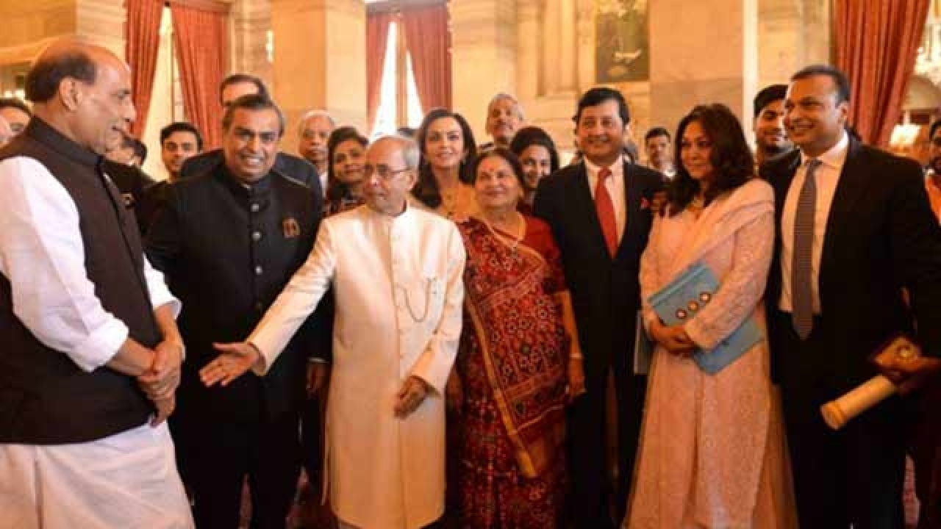

Slide 25
Weblink
https://www.businessinsider.com.au/ambani-brothers-feud-reliance-2011-05#july-2002-dhirubhai-ambani-dies-1

Slide 26
Commercestudyguide.com

