Slide 1
CONTEMPORARY ROLE MODELS IN INDIAN BUSINESSES
TORAN LAL VERMA
DHSGU, SAGAR

Slide 2
CONTEMPORARY ROLE MODELS IN INDIAN BUSINESSES
There are a huge number of entrepreneurs doing very well for them as well as for the economy. it is very important for us to learn their values.
We have discussed three influential women entrepreneurs in this presentation.

Slide 3
KIRAN MAZUMDAR SHAW:
Kiran Mazumdar is an Indian entrepreneur. She is the Chairman & Managing Director of Biocon Limited a biotechnology company based in Bangalore.
Kiran Mazumdar-Shaw was born on March 23, 1953 in Bangalore, India.
Mazumdar-Shaw completed her schooling from the city’s Bishop Cotton Girl’s High School (1968).
She wanted to join medical school but inste ead took up biology and completed her BSc Zoology Honors course from Mount Carmel College, Bangalore University (1973).
She later did her post-graduation in Malting and Brewing from Ballarat College, Melbourne University (1975).

Slide 4
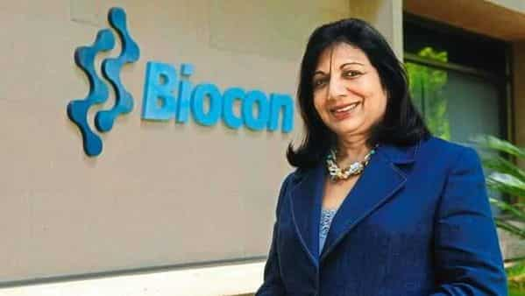
KIRAN MAZUMDAR SHAW:

Slide 5
She worked as a trainee brewer in Melbourne and as a trainee maltster in Australia.
She also worked for some time as a technical consultant at Jupiter Breweries Limited, Calcutta and as a technical manager at Standard Makings Corporation, Baroda between 1975 and 1977.
She started Biocon in 1978 and spearheaded its evolution from an industrial enzyme manufacturing company to a fully integrated bio-pharmaceutical company with a well-balanced business portfolio of products and a research focus on diabetes, oncology and auto-immune diseases. She also established two subsidiaries- Syngene in 1994.

Slide 6
Her pioneering work in the sector has earned her several awards, including the prestigious Padma Shri in 1989 and the Padma Bhushan in 2005 from the government of India.
She was recently named among TIME magazine’s 100 most influential people in the world. She is on the Forbes list of the world’s 100 most powerful women and the Financial Times’ top 50 women in business list.
She is also a member of the board of governors of the prestigious Indian School of Business and Indian Institute of Technology Hyderabad.

Slide 7
Her Values:
Belief in herself
Leadership
Vision
Go-getter spirit
Not afraid of failures

Slide 8
Her Business Philosophy:
Ethics in business
Precision in work
Quality matters the most

Slide 9
Her Behavioral Orientation:
Courageous
Undeterred by set-backs
Corporate citizenship

Slide 10
Dr. Swati Piramal:
Swati A. Piramal is the Vice Chairperson of Piramal Life Sciences Limited and Director of Piramal Healthcare Limited.
Dr. Piramal received one of India’s highest civilian honour’s, the Padmashri award, by the President of India, Ms. Pratibha Patil on 4th April, 2012.
She has been nominated as one of the 25 Most Powerful Business Women in India eight times and is now a member of the Hall of Fame of the Most Powerful Women.
She was the first woman in 90 years to head the Apex Chamber of Commerce ASSOCHAM in 2009-10.
She has contributed towards innovations in Public Health Services and other projects.

Slide 11
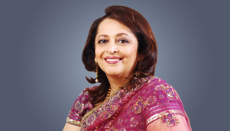
SWATI PIRAMA

Slide 12
She has been a part of public policy related to health care which led to major policy changes that help reduce the spread of life-threatening diseases.
Dr. Swati Piramal also serves on Indian Government public policy expert committees for trade, planning, environment, arts, women’s entrepreneurship, national integration and regional development.
Dr. Piramal is a member of many Indian and foreign business councils, and has received numerous Indian and international awards.

Slide 13
Her Values:
Doing good for society
Extending helping hand
Courtesy & humility
Her Business Philosophy:
Innovation as mantra of success
Ethical business

Slide 14
Her Behavioural Orientation:
Hard working
Persistence
Enthusiasm
Self confidence

Slide 15
Vandana Luthra:
Vandana Luthra is an entrepreneur who can be said to be embodiments of her enterprise. She is slim and svelte.
She carries herself with the grace that only comes with enormous self-confidence. She’s the founder and mentor of the VLCC, India’s leading slimming, beauty and fitness brand, and one with seven outlets in Abu Dhabi, Dubai and Sharjah, and many more to open.
There are VLCC slimming, beauty and fitness centers in Muscat and Bahrain, and by next year there will be a total of some 28 across the Middle East.

Slide 16
Vandana Luthra:

Slide 17
The largest number of VLCC centers, of course, is in Ms. Luthra’s native India – 150 of them in 75 cities. She facilitates professional development through her vocational training school, the VLCC Institute of Beauty, Health & Management, which currently has 43 campuses in 35 cities.
Ms. Luthra says “The entrepreneur as an educator – That would be a fair way to characterize me and Fitness and well-being are a matter of education, and for that you need skilled trainers.”
Her own training after graduating from Delhi University was in nutrition and cosmetology in Germany. Then Ms. Luthra took a series of specialized courses and modules in beauty care, fitness, food and nutrition and skin care in London, Munich and Paris. And then she returned to her middle-class home in New Delhi, India’s capital, and started a neighbourhood beauty parlour.

Slide 18
Values:
Good clean business
Doing good to women in particular
Belief in good heath
Business Philosophy:
Healthy life – Happy life

Slide 19
Behavioural Orientation:
Good communication
Smart & sophisticated
Good soft skills

Slide 20
Weblink
https://www.businessmanagementideas.com/business/role-models/contemporary-role-models-in-indian-business/18182

Slide 21
Commercestudyguide.com

